Slide 1
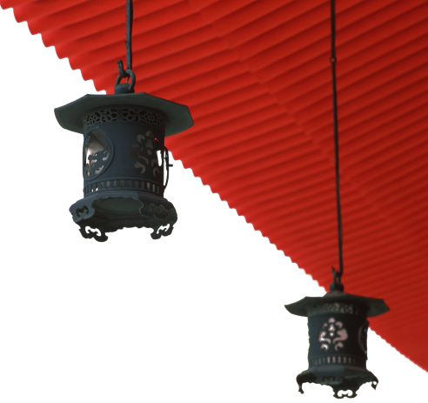


中国文化概况
A GLIMPSE OF CHINESE CULTURE

Slide 2
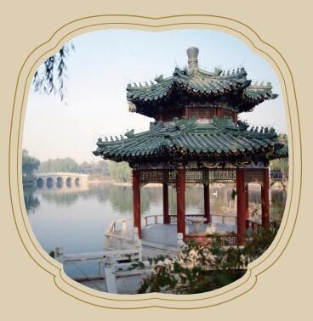
Chapter10
Architecture

Slide 3

学习目标
1.掌握中国古代建筑的特点
2.了解中国古代建筑的主要类型
3.介绍中国桥梁
4.辨认典型的中国风格建筑

Slide 4
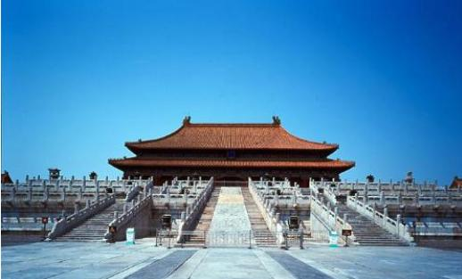
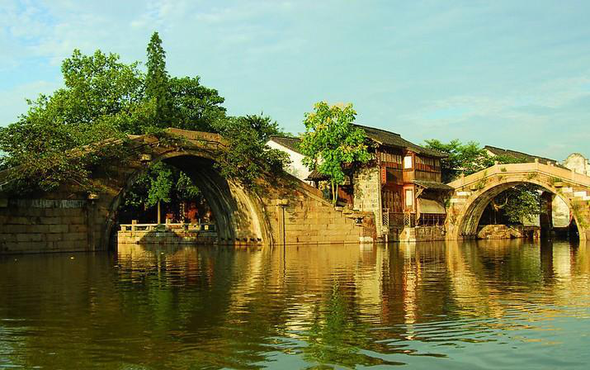

1
2
Overview
3
Lead-in Activity
Text Study
Discussion &
Presentation

Slide 5
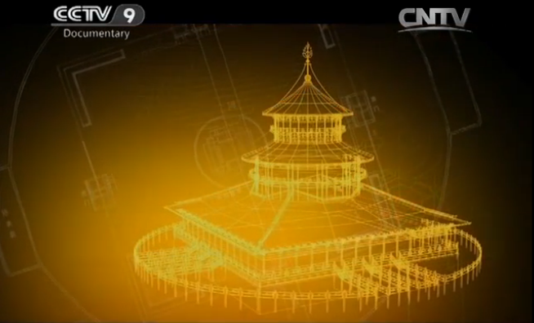
Lead-in Activity
Watch & Think
Watch the video clip and discuss:
What ancient Chinese architecture impresses you most？
Are there any residential houses with distinct features in your
hometown？

Slide 6
1
2
Overview
3
Lead-in Activity
Text Study
Discussion &
Presentation

Slide 7
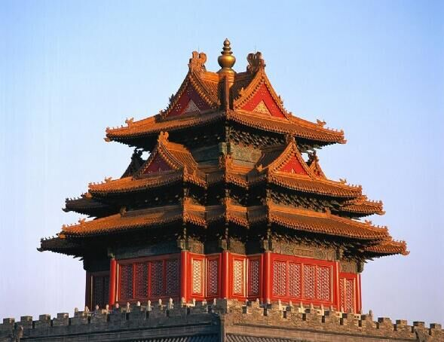
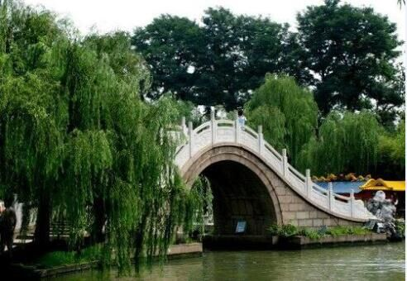
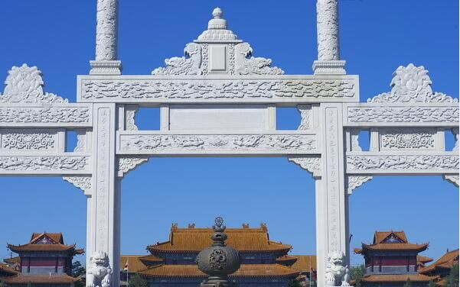
Text Study
1
2
3
Traditional Chinese Architecture
Typical Chinese structure and ornament
Chinese Bridge

Slide 8
Traditional Chinese Architecture
Characteristics of Traditional Chinese Architecture
Timber Framework
Plain, Flexible and Beautiful Layout
The Building Materials
Artistic Roof Design
Colorful Painting

Slide 9
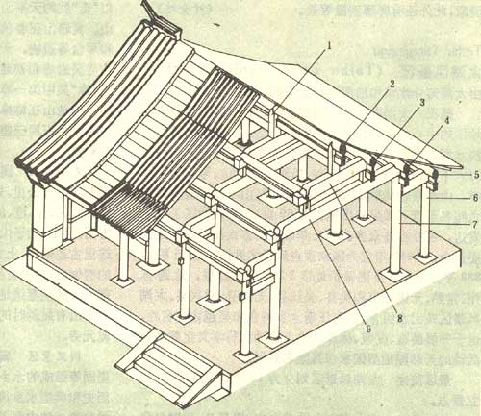
Characteristics of Traditional Chinese Architecture

Slide 10
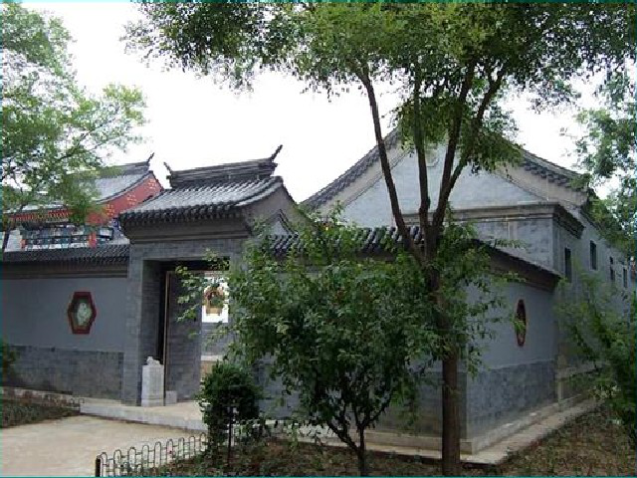
Characteristics of Traditional Chinese Architecture
Plain, flexible and beautiful layout
Chinese structures are based on the
principle of balance and symmetry
the main structure is the axis
The secondary structures were
positioned as two wings on either
side to form the main room and yard.

Slide 11
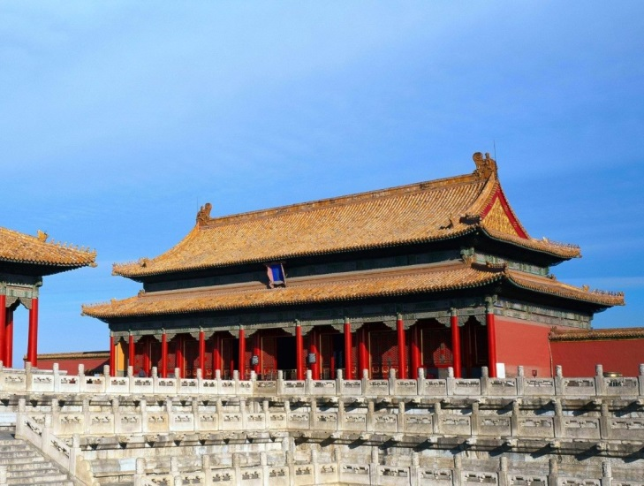
Characteristics of Traditional Chinese Architecture
The building materials
timbers, bricks and tiles.
the glazed tile: high-grade
building material, palace
building, large mansions of
some nobles and officials
gray tile: residences of nobles
and officials

Slide 12
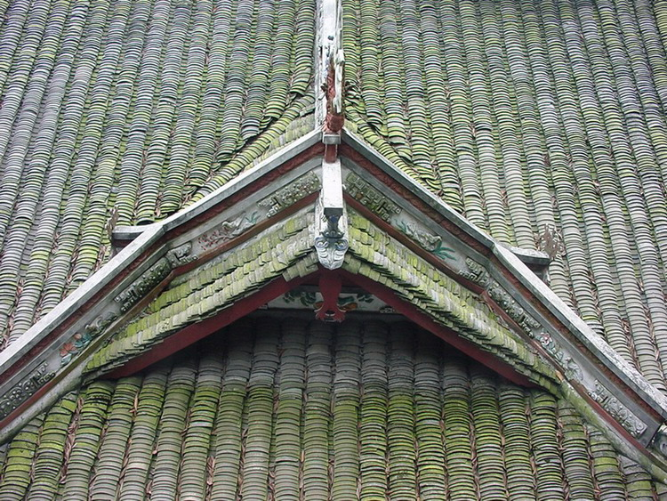
Characteristics of Traditional Chinese Architecture
The artistic roof design
huge roofs with extended eaves
to ensure enough lighting
to avoid the dampening of the walls
to ward off evil spirits in temple
zoomorphic ornaments called
wenshou(吻兽)
a traditional practice: placing animal
figures on roof ridges

Slide 13
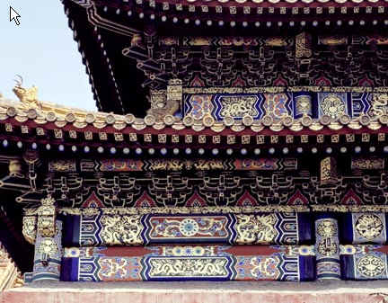
Characteristics of Traditional Chinese Architecture
The colorful paint
plays the roles of
decoration and protection.
initially used on wood for
antisepsis (防腐)
Later, it became an
architectural ornament

Slide 14
Traditional Chinese Architecture
Imperial Architecture
Imperial mausoleums
Imperial palaces
The meaning of number nine

Slide 15
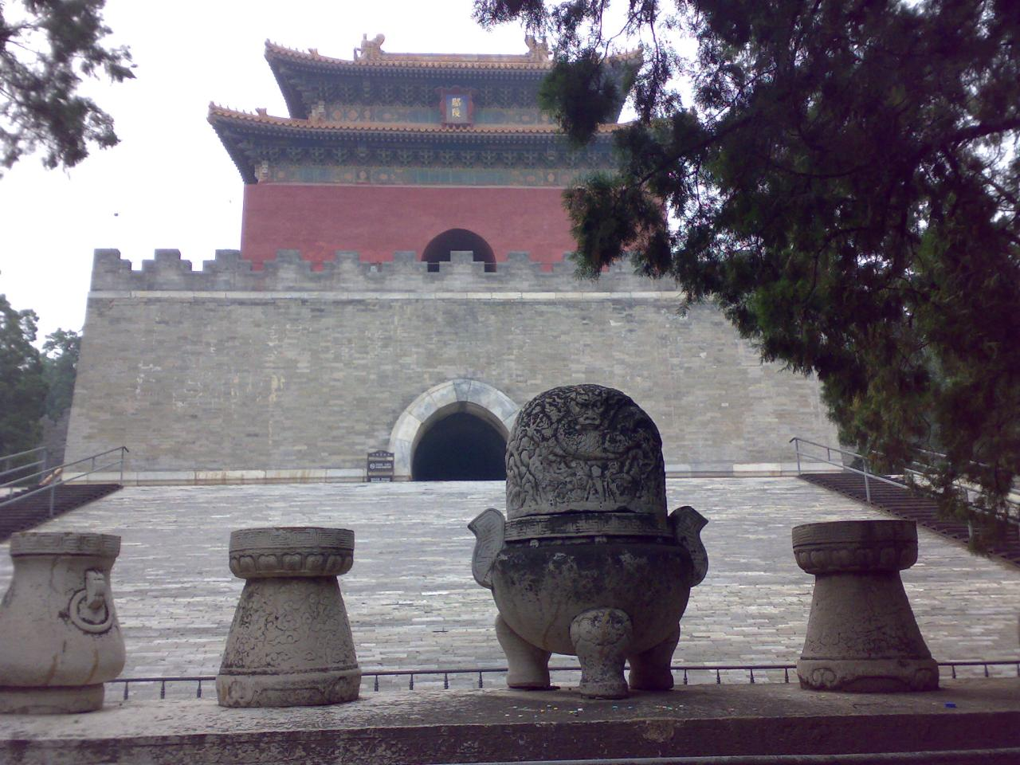
Imperial Architecture
Imperial mausoleums
represented the highest
architectural techniques of their
times
usually built against hills or
mountains and face plains

Slide 16
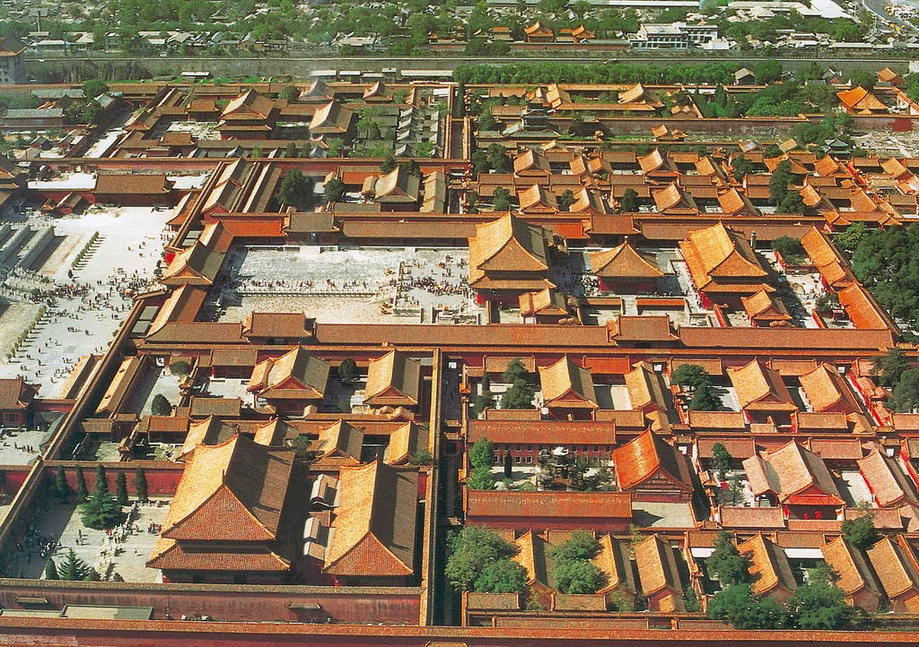
Imperial Architecture
Imperial palaces
emperors lived
administered their court
the most revered, luxurious
and grandiose architectural
types

Slide 17
Imperial Architecture
The meaning of number nine
odd numbers represent yang; even numbers yin
Nine is the largest odd number under ten, it was
regarded an extremely lucky number.
emperors liked to monopolize it to symbolize their
superiority
Designs related to nine appeared almost on every
imperial structure.

Slide 18
Traditional Chinese Architecture
Civilian Residential Housing
Since China is a country of diverse natural environments and cultural traditions, its civilian residential housing features diverse styles.
Beijing quadrangles
Shanxi cave dwellings
Huizhou residential houses
Hakka castle-like dwellings客家土楼

Slide 19
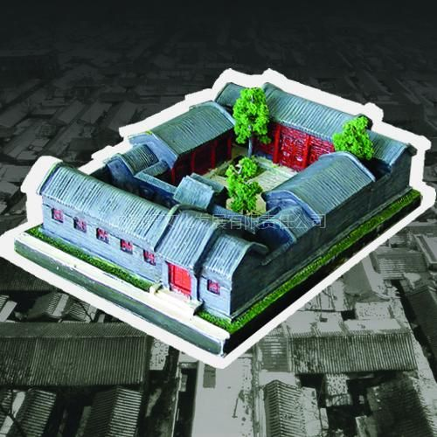
Civilian residential housing
Beijing quadrangles (北京四合院)
formed by four inward-facing houses
linked by enclosing walls
the principal room: family rituals take
place and distinguished guests are welcomed
all rooms face a courtyard
screen wall: to prevent outsiders from
peeping in影壁墙

Slide 20
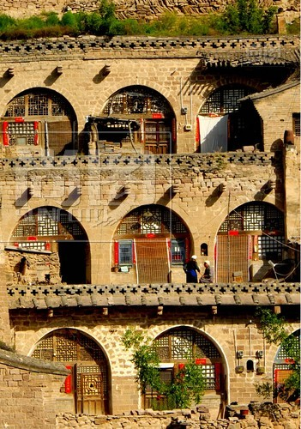
Civilian residential housing
Shanxi cave dwellings (窑洞)
the northwest Loess Plateau of China；
the middle and upper reaches of the
Yellow River
natural condition of dry weather, little
rain, cold winter and limited timber
warm in winter and cool in summer
Economical, require almost no timber
in construction

Slide 21
Civilian residential housing
Huizhou residential houses
embraced local physical features
incorporated fengshui concepts and aesthetic trends
black tiles, white walls and decorations placed elegantly on
upturned eaves飞檐
the garden-style with exquisite carvings on the doors and
windows
doorframe constructed with one stone rather than a wood

Slide 22
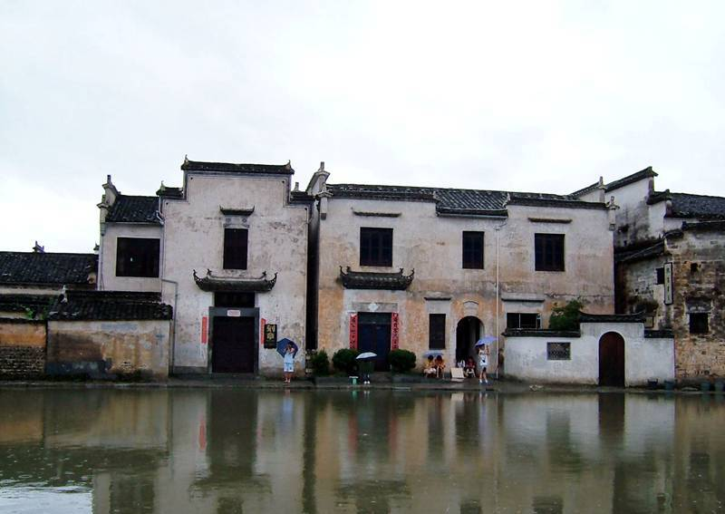

Slide 23
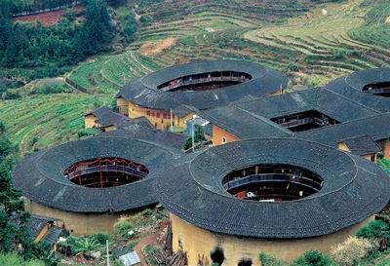
Civilian residential housing
Hakka castle-like dwellings (客家土楼)
overall building complexes are round or
square
some in the style of large mansions or in
the shape of the Eight Trigrams八卦.
usually three to four floors
the tallest complexes have up to six floors
a building holds more than 50 families

Slide 24
Some Ethnic Houses
Dai bamboo house
the traditional dwelling of the Dai people
square in shape, two storeys.
living quarters: the upper storey, supported by wooden poles
and more than two meters above the ground
the open-walled lower storey is for raising domestic animals
and for storage
the building has an oblique (斜的) roof, shaped as an upside
down, covered with grass or tiles.
the upper storey: inner bedrooms and an outer living room

Slide 25
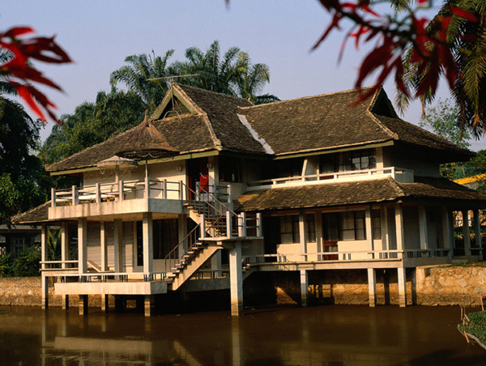

Slide 26
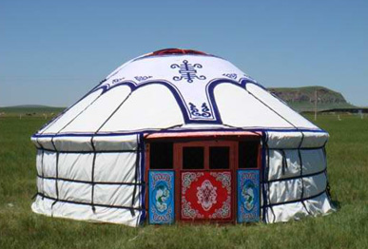
Some Ethnic Houses
Mongolian yurts (蒙古包)
Mongolian yurts are felt tents.
Wooden poles are fastened with
leather thongs 皮条and studs 钉to form a fence-like structure
Each part of the yurt is quite
convenient to disassemble and carry.

Slide 27
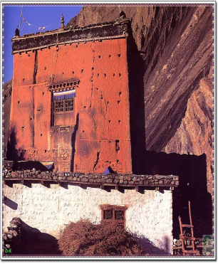
Some Ethnic Houses
Stone chamber(碉房)
the most popular dwelling of the Tibetan
Built mostly of stone and earth, they look
like blockhouses (diaobao), hence the
name of diaofang
the first floor is often used for livestock
and poultry牲畜和家禽
generally of three storeys or more

Slide 28
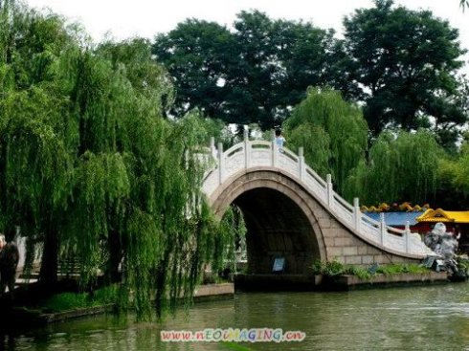
Text Study
1
2
3
Traditional Chinese Architecture
Chinese Bridge
Typical Chinese structure and ornament

Slide 29
Chinese Bridge
China has inherited innumerable bridges from her past.
In the southern regions of rivers and lakes,
the landscape is dotted with bridges of various sizes and
descriptions.
distinctive characteristics, varying building materials and
different forms

Slide 30
Chinese Bridge
The Stone Arch Bridge (石拱桥)
The Zigzag Bridge (曲折桥)
The Pavilion Bridge ( 亭桥 )

Slide 31
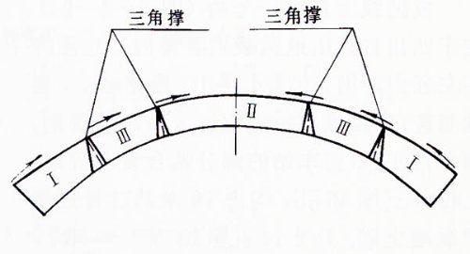
The Stone Arch Bridge
Lvrenqiao
the first Chinese stone arch bridge named Lvrenqiao
was built round 282 in Luoyang

Slide 32
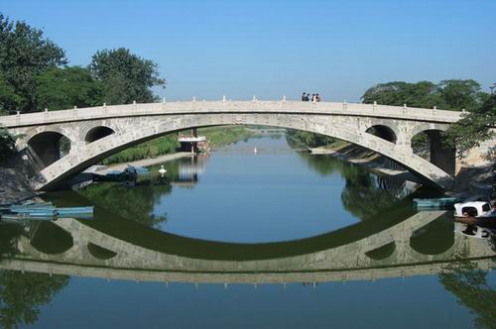
The Stone Arch Bridge
the most famous stone arch bridge in China
spans the Jiaohe River in Zhaoxian County，Hebei Province
built in the year of 605 by the mason (石匠) Li Chun
is still being used today, making it one of the bridges with
the longest service life in the world
Anji Bridge/Zhaozhou Bridge

Slide 33
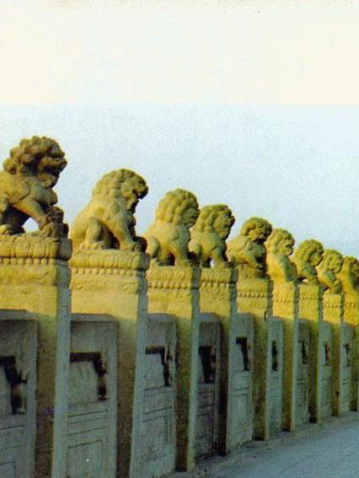
The Stone Arch Bridge
Lugouqiao /Marco Polo Bridge卢沟桥
over the Yongding River
built in the years from 1189 to 1192 in the
southwest of Beijing
265 metres long and comprises 11 arches
with spans ranging from 16 to 21.6 metres
the stone lions engraved on the
balustrades (扶栏) on both sides
the 501 stone lions: lively and exquisite
with different expressions and postures

Slide 34
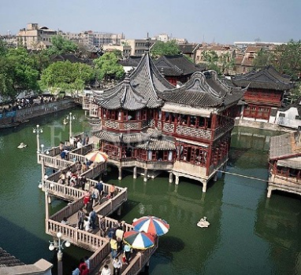
The Zigzag Bridge (曲折桥)
found in some gardens or suburban parks.
give an interesting scenic feature to lakes and ponds.
may have three, five or more zigzags
often built over the surface of a quiet lake,
forming a small scenic area
providing sightseers with a place of rest,
a shelter from the sun and rain.

Slide 35
The Pavilion Bridge
The Five-Pavilion Bridge 五亭桥
in Yangzhou, Jiangsu Province
built in 1757, has five pavilion resembling a belt worn on
the narrow waist of Slender West Lake
one pavilion is higher than the other four, two on each side
in perfect symmetry.
the middle pavilion is the only double-eaved structure.
all pavilions have their four corners upturned, with rows of
tiles under a crown roof.

Slide 36
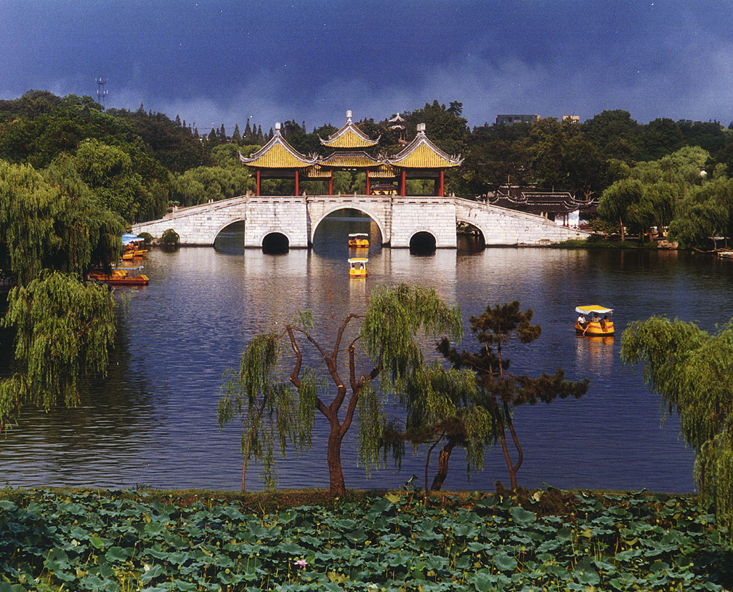

Slide 37
The Pavilion Bridge
The Chengyang Bridge程阳永济桥
built in 1912
also known as Wind-and-Rain Bridge, over the Linxi River in
the Dong Autonomous County of the Guangxi Zhuang
Autonomous Region
wooden body, 77.6 metres long and 3.75 metres wide, rests
on piers built entirely of large stone blocks
standing above are five pagoda-like pavilions connected by
a long covered corridor

Slide 38
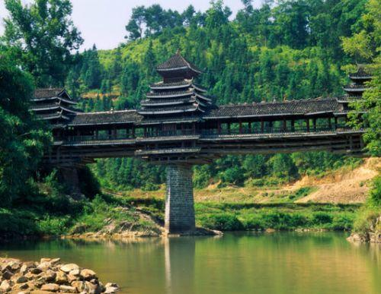

Another well-known pavilion bridge, built in 1916, is Chengyang Bridge, also known as Wind-and-Rain Bridge, on the Linxi River in the Dong Autonomous County of the Guangxi Zhuang Autonomous Region. Its wooden body, 70 metres long by 10 metres wide, rests on piers built entirely of large stone blocks. Standing above are five pagoda-like pavilions connected by a long covered corridor forming a covered bridge.

Slide 39
study text
1
2
3
Traditional Chinese Architecture
Chinese Bridge
Typical Chinese structure and ornament

Slide 40
Typical Chinese structure and ornament
There is a variety of typical Chinese structures and ornaments and each exemplifies China’s rich architectural heritage.
Chinese Stone Lions
Huabiao
Pavilions
Pagodas
Paifang

Slide 41
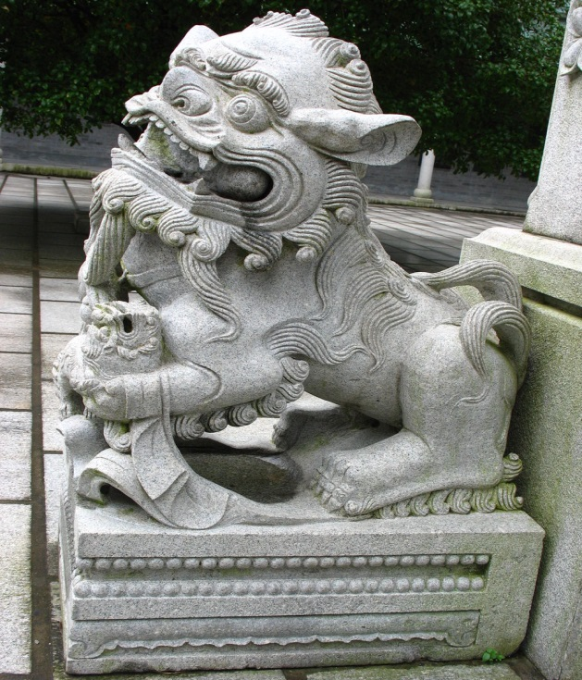
Typical Chinese structure and ornament
Chinese Stone Lions
The lion is regarded as the king of
animals and ruler of the forest In China.
A symbol of power and grandeur.
A lion ornament can offer protection
from evil spirits.
in front of traditional palace halls, old
government offices, temples

Slide 42
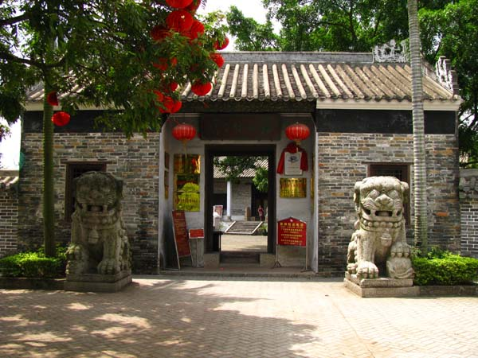
Typical Chinese structure and ornament
The male is on the left, his right
paw resting on a ball, and the
lioness on the right, her left paw
fondling a cub.幼崽
The ball symbolizes the unity of
the empire; the cub with the
lioness represents thriving offspring.
Also used to indicate the ranks of
officials in ancient time

Slide 43
Typical Chinese structure and ornament
Huabiao
ornamental or symbolic column erected in front of a palace
or tombs or other places
usually carved with dragon and auspicious clouds
a typical huabiao has a round or octagonal base 八角形底座and a transverse-engraved stone slab 横向雕刻石板on its top.
functioned as a road sign
also used to record criticism against kings and minister
became a pure ornament erected in front of buildings

Slide 44
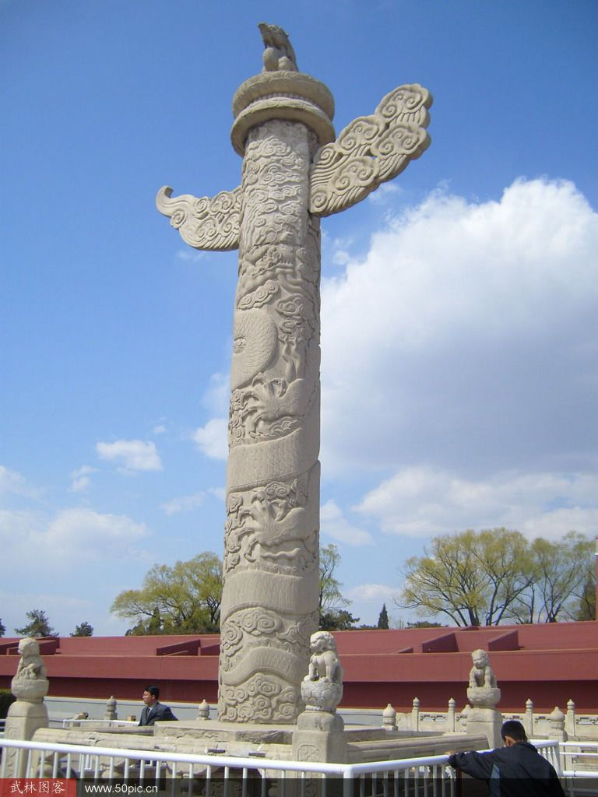
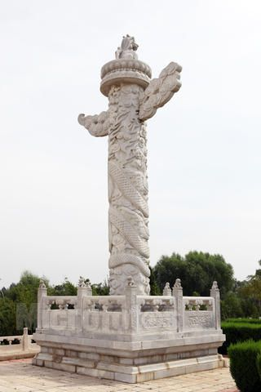
Typical Chinese structure and ornament

Slide 45
Typical Chinese structure and ornament
Pavilions
built of wood, stone or bamboo
the floor may adopt the square, triangular, hexagonal六边形, octagonal八边形, five-petal flower or fan shape扇形.
have columns to support the roof, but no walls.
in parks or at scenic spots, are built either on slopes to
command panoramic (全景的) views or by the lakeside to
create intriguing (有魅力的) images in the water

Slide 46
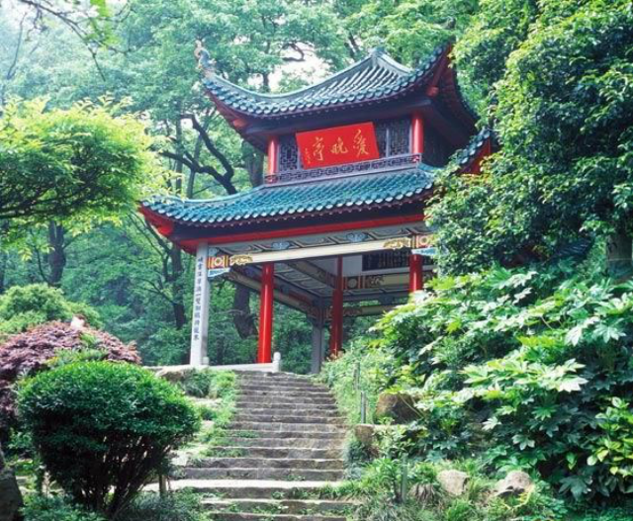
Typical Chinese structure and ornament

Slide 47
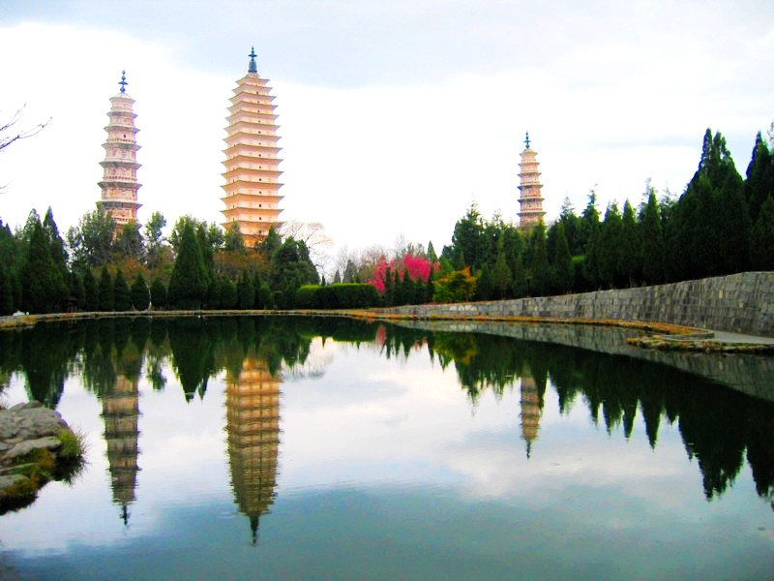
Typical Chinese structure and ornament
Pagodas
in various sizes and shapes.
Some resemble towers, others pavilions and others are
similar to pyramids.
Some stand alone, and others have been built in clusters.
Tower-style pagodas (楼阁塔)
Multi-eaved pagodas (密檐式塔)
Pavilion (or one-story )pagodas
Lamaist pagodas (喇嘛塔)

Slide 48
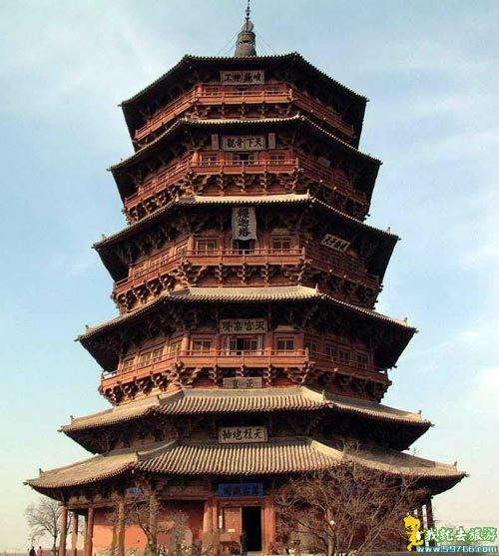
Pagodas
Tower-style pagodas (楼阁塔)
Multi-storey towers
Ying County Wooden Pagoda (应县木
塔) : the oldest and tallest of this type;
in Shanxi Province.
Built in 1056, 67.1-meter-high;
octagonal structure of five stories

Slide 49
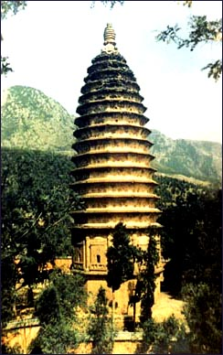
Pagodas
Multi-eaved pagodas (密檐式塔)
Names come from the many tiers of
closely set eaves at the top of the structures.
Mostly built of bricks and stones.
Without doors or windows but have holes
to let in light.
The earliest example is at Songyue Temple
on Mount Songshan in Henan Province. Built
in 509, stands 40 meters high and has 12
sides capped by 15 tiers of eaves.

Slide 50
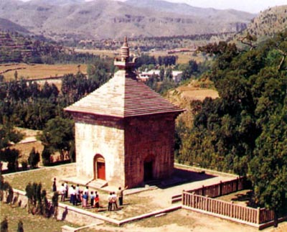
Pagodas
Pavilion or one-story pagodas
Used as tombs for abbots and
other high-ranking monks.
The earliest of these still existing
is Simen Pagoda at Shentong
Temple in Shangdong Province
(about 1,400-year-old)
square, with a single roof and one
door on each side.

Slide 51
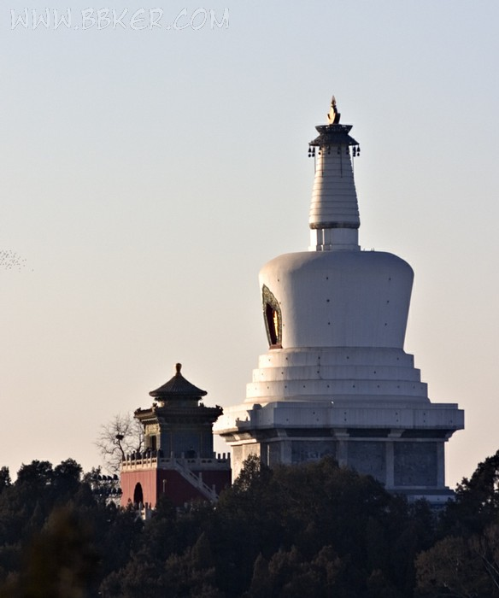
Pagodas
Lamaist pagodas (喇嘛塔)
similar to Indian stupa ([佛教]舍
利塔).
dome-shaped structures set on
large pyramidal platforms.
one famous example: the White
Pagoda in Beihai Park in Beijing.

Slide 52
Typical Chinese structure and ornament
Paifang (牌坊)
also called pailou
An archway usually made from fine wood or stone
Well painted and with glazed tiles sometimes
moral inscriptions by some calligraphers are carved into the
middle beam.
usually stand in downtown areas; the entrances of
mausoleums, temples, bridges and parks.
Build to commemorate historical events and important
figures

Slide 53
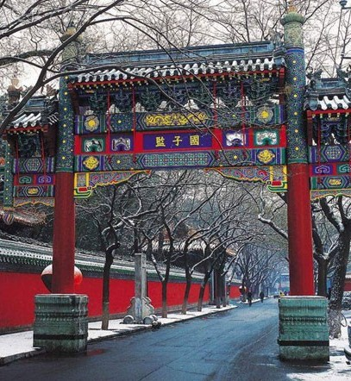
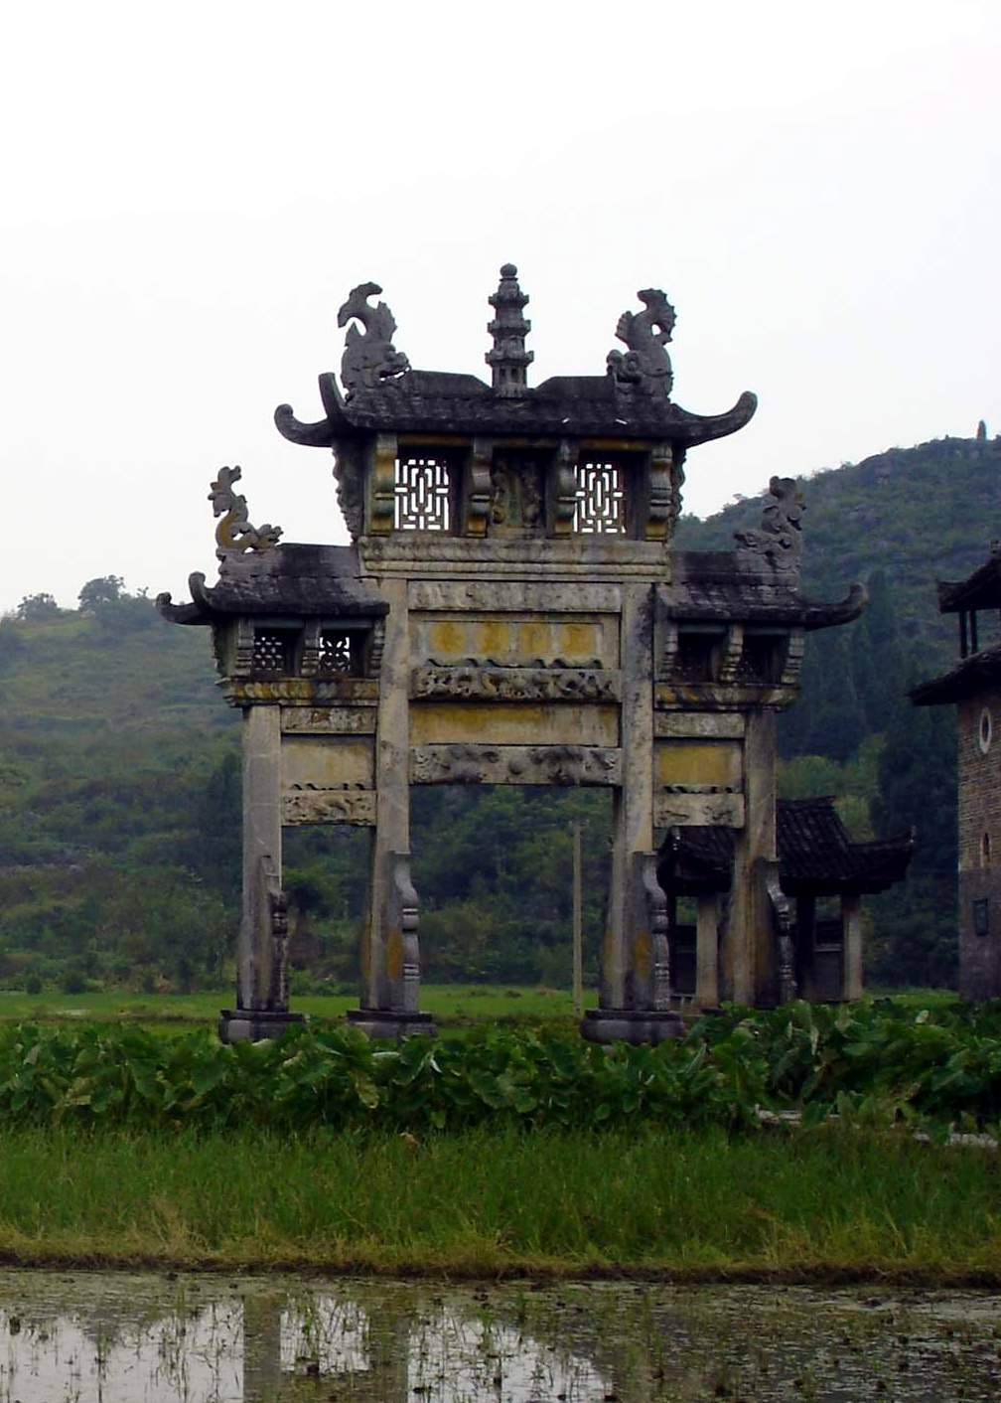
Typical Chinese structure and ornament

Slide 54
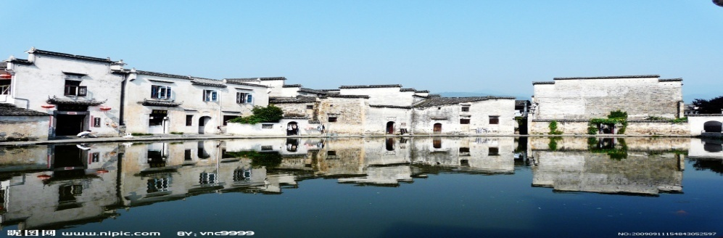
1
2
Overview
3
Lead-in Activity
Text Study
Discussion &
Presentation

Slide 55
Discussion
Fill in the following blanks with the information you learn from your knowledge.
1 The ancient Chinese used extensively as a building
material in addition to bricks and tiles.
2 The number carried a special meaning in ancient
China. It was deemed that odd numbers represented while even numbers .
3 The history of Hakka earth buildings dates back to when Hakka people migrated from central China to .
4 Based on their style of construction, pagodas can roughly be
classified into four categories: the , multi-eaves, and Lamaist styles.
timber
nine
yang
yin
the Tang dynasty
The coastal province of Fujian
tower
Pavilion/one-storey

Slide 56
Discussion
Many old and historic buildings are well protected in China. However, city planners always have to face the question whether old buildings should be demolished to make way for progress.
Discuss with your partner about the significance of preserving old buildings and possible ways of striking a balance between preservation and urbanization in China. Then share your ideas with the class.

Slide 57
Students’ Presentation
You study in a city which boasts some famous historic buildings. When a group of international tourists visit your city, you are invited to serve as a guide to introduce one of the historic buildings to them.
Your introduction should cover the following points:
1 the time when it was built
2 its material
3 its structure
4 its characteristics
5 its cultural importance

Slide 58
The End

